Slide 1
MICRO CREDIT DEFAULTER PROJECT
CHAMLIN NAJIR RAHMAN

Slide 2
PROBLEM STATEMENT
A Microfinance Institution (MFI) is an organization that offers financial services to low income populations. MFS becomes very useful when targeting especially the unbanked poor families living in remote areas with not much sources of income. The Microfinance services (MFS) provided by MFI are Group Loans, Agricultural Loans, Individual Business Loans and so on.
We are working with one such client that is in Telecom Industry. They are a fixed wireless telecommunications network provider. They have launched various products and have developed its business and organization based on the budget operator model, offering better products at Lower Prices to all value conscious customers through a strategy of disruptive innovation that focuses on the subscriber.
They are collaborating with an MFI to provide micro-credit on mobile balances to be paid back in 5 days. The Consumer is believed to be defaulter if he deviates from the path of paying back the loaned amount within the time duration of 5 days. The sample data is provided to us from our client database. In order to improve the selection of customers for the credit, the client wants some predictions that could help them in further investment and improvement in selection of customers.

Slide 3
EDA STEPS
Exploratory Data Analysis.
Here we clean, analyze and visualize the given data, and then draw conclusions.
Step 1 : Importing the required libraries, like numpy, pandas, matplotlib and seaborn.
Step 2 : Importing the excel dataset into jupyter notebook.
Step 3 : Gather information about the dataset, like, columns, shape, datatype, null values, skewness, unique value count for each feature, statistical information using describe(), etc.

Slide 4

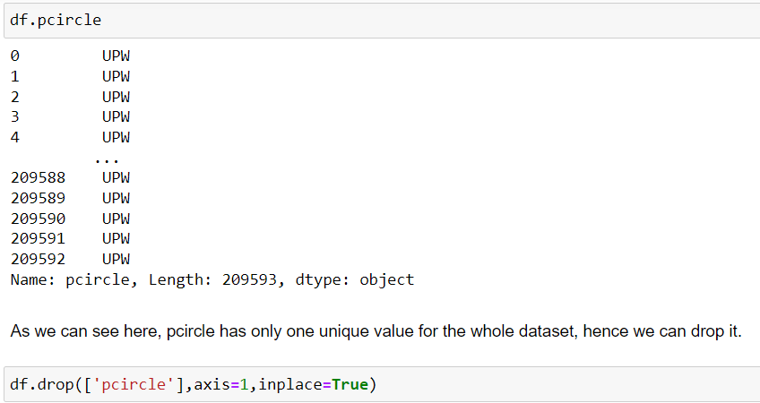
Dropping Columns :

Slide 5
VISUALIZATIONS :
Countplot for univariate analysis.
Distribution plot for the continuos numeric columns.
Boxplot to check for outliers present in the features.
AUC ROC Curve

Slide 6
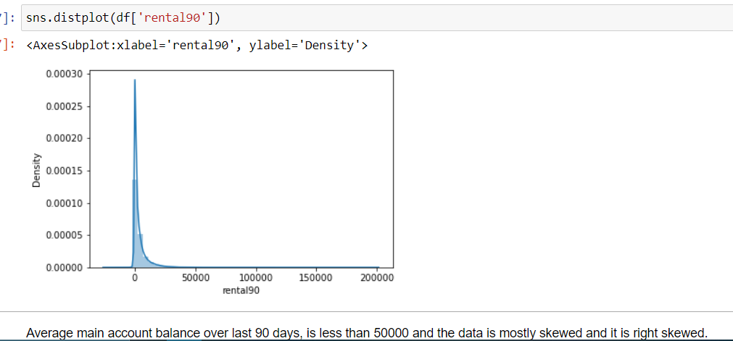
Example

Slide 7
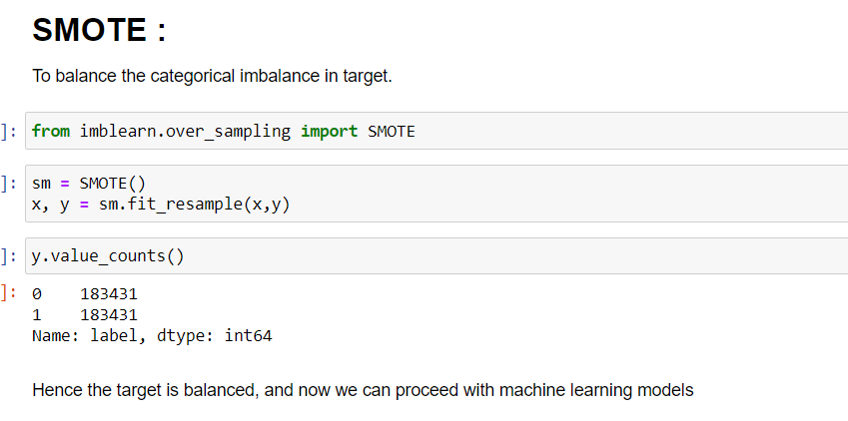
SMOTE

Slide 8
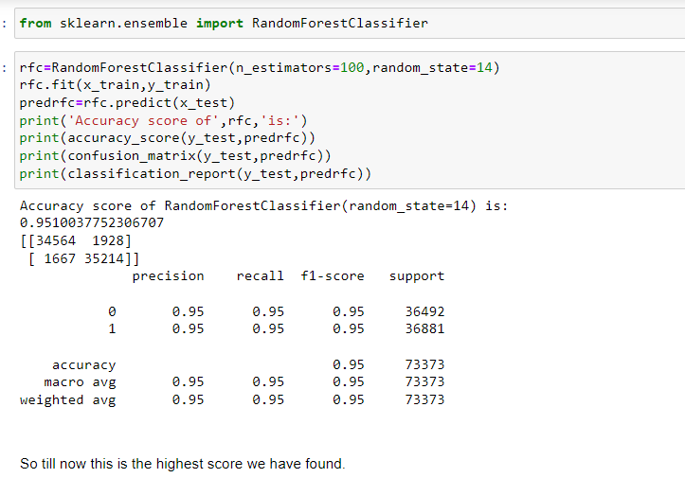
Best Model

Slide 9
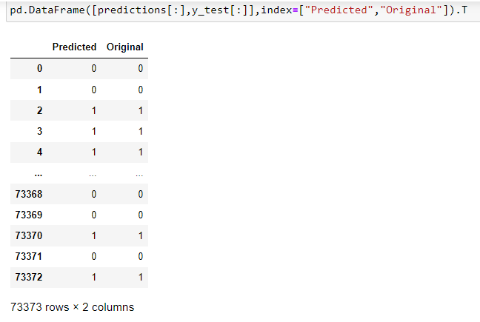
Predictions

